Slide 1
Finding Most Influential Papers Based on DBLP Citation Network
By:
Saurabh Pathak Sonali Priya

Slide 2
Overview
Introduction
Procedure
Map Reduce Implementation
Hive Implementation
Conclusion
Reference

Slide 3
Introduction
In this project we implemented the page rank algorithm which was innovated by Google upon the DBLP citation network dataset.
We have performed 10 iterations using the Hive Script to find the top ten ranked pages. We used the map reduce to find the page index and the citations..

Slide 4
Procedure
We used the map reduce to get the paper index and its citation
Saved all the output in a file Link.txt.
Used Hive script to calculate the page rank and perform the 10 iterations.
Saved the output in the file paper_rank.txt.

Slide 5
Map Reduce Implementation
DBLP Input Format : We have used DBLPInputFormat.java class where we parse the given DBLP-Citation-network V7 data. We have used several overridden methods of InputFormat and RecordReder like createRecordReader(), nextKeyValue(), getCurrentKey(), etc. to achieve this.
Mapper: We used PageRankMapper.java class to parse the output from the DBLP input format. We get the input in mapper in the format like #*………….\n\n\n!#. We parse this input in mapper to emit key as index of page and the value as reference index.

Slide 6
Reducer: We use PageRankReducer.java class to emit all the pages with its corresponding page references as a link graph.

Slide 7
Code
Driver Class Settings:
Job job= new Job(getConf());
job.setJarByClass(PageRankDriver.class);
job.setJobName("pagerank");
//Setting the mapper, reducer classes
job.setMapperClass(PageRankMapper.class);
job.setReducerClass(PageRankReducer.class);
job.setInputFormatClass(DBLPInputFormat.class);
//Setting the format of the key-value pair to write in the output file.
job.setOutputKeyClass(IntWritable.class);
job.setOutputValueClass(IntWritable.class);

Slide 8
Code
Mapper Class Logic:
String line = value.toString();
StringTokenizer record = new StringTokenizer(line, "\n");
int index = 0, citedIndex = 0;
while (record.hasMoreTokens()){
String token = record.nextToken();
if(token.contains("index")){
try{ index =
Integer.parseInt(token.substring(token.indexOf("x")+1).trim());
}catch(NumberFormatException exp){
index = -1;
}
}

Slide 9
Code
Mapper Class Logic:
else if(token.contains("%")){
try{ citedIndex = Integer.parseInt(token.substring(token.indexOf("%")+1).trim());
}catch(NumberFormatException exp){ citedIndex = -1;}
if(index != -1 && citedIndex != -1) context.write(new IntWritable(index), new IntWritable(citedIndex));
} }

Slide 10
Code
Reducer Class Logic:
public class PageRankReducer extends
Reducer<IntWritable, IntWritable, IntWritable, IntWritable>
{
public void reduce(IntWritable key, Iterable<IntWritable> values, Context context) throws IOException, InterruptedException {
for (IntWritable value : values) {
context.write(key, value);
}
}
}

Slide 11
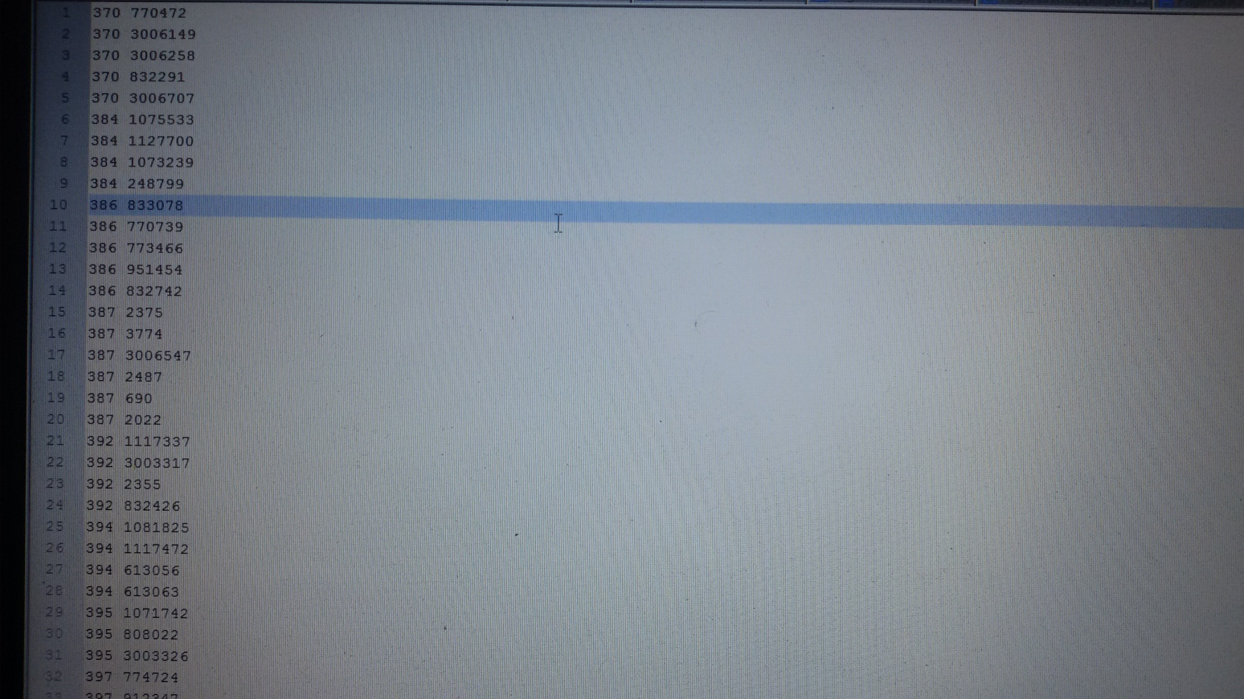
Map reduce Output

Slide 12
Hive Implementation
Loaded the link graph data into mpRedOp table.
Created a table IncOnly and selected only the indices which had incoming links.
Created a table which will have indices, all of it’s incoming links, no. of outgoing links of all incoming links, page rank of incoming links as four columns and loaded initial data into it before first iteration.

Slide 13
Wrote a script to take summation of page ranks of incoming links and eventually calculating the page rank of indices and updated all new page ranks.
Repeated the above steps 10 times to get the page ranks after 10 iterations.
Wrote a script to find the top ten page ranks and store it in a text file which is the required paper_rank.txt.

Slide 14
Script
/***** load link graph ******/
create table mpRedOp(PI INT, PJ INT)row format delimitedfields terminated by '\t';
load data local inpath '/home/administrator/Downloads/mapRedOutput' into table mpRedOp;
/***** select incoming links *****/
create table IncOnly(Incoming INT)row format delimitedfields terminated by '\t';
create table Incoming(Node INT, Incoming INT)row format delimited
fields terminated by '\t';
insert overwrite table IncOnly
select PI from mpRedOp where PI IN(select PJ from mpRedOp);
insert overwrite table Incoming
select inc.Incoming, mp.PI from IncOnly inc, mpRedOp mp where inc.Incoming=mp.PJ group by inc.Incoming, mp.PI;
insert overwrite table Incoming
select mp.PI, inc.Incoming from mpRedOp mp left outer join Incoming inc on inc.Node=mp.PI group by mp.PI, inc.Incoming;

Slide 15
Script
/******** innitialize table for page rank calculation **************/
create table Outgoing(PI INT, Cnt INT, PR DOUBLE)
row format delimited
fields terminated by '\t';
insert overwrite table Outgoing
select PI, count(PJ), 1/564705 from mpRedOp group by PI;
create table PR_Rank(PI INT, Inc INT, Outg INT, PR DOUBLE)
row format delimited fields terminated by '\t';
insert overwrite table PR_Rank
select inc.Node, inc.Incoming, outg.Cnt, 1/564705 from Incoming inc left outer join Outgoing outg on inc.Incoming=outg.PI;
create table PR_Rank_Iter(PI INT, Inc INT, Outg INT, PR DOUBLE)
row format delimited
fields terminated by '\t';
create table PR_Iter(PI INT, PR DOUBLE)
row format delimited
fields terminated by '\t';

Slide 16
Script
/******** page rank 10 iterations calculation **************/
insert overwrite table PR_Rank_Iter
select PI, Inc, Outg, 0.85*(PR/Outg) from PR_Rank where Inc IS NOT NULL;
insert into table PR_Rank_Iterselect PI, Inc, Outg, (0.15/564705) from PR_Rank where Inc IS NULL;
insert overwrite table PR_Iter
select PI, ((0.15/564705)+sum(PR)) from PR_Rank_Iter where Inc IS NOT NULL group by PI;
insert into table PR_Iter
select PI, sum(PR) from PR_Rank_Iter where Inc IS NULL group by PI;
insert overwrite table PR_Rank_Iter
select prr.PI, prr.Inc, prr.Outg, prit.PR from PR_Rank prr left outer join PR_Iter prit on prr.Inc=prit.PI where prr.Inc IS NOT NULL order by prr.PI;
insert overwrite table PR_Rank
select prr.PI, prr.Inc, prr.Outg, (0.15/564705) from PR_Rank prr left outer join PR_Iter prit on prr.Inc=prit.PI where prr.Inc IS NULL order by prr.PI;
insert into table PR_Rank
select PI, Inc, Outg, PR from PR_Rank_Iter;

Slide 17
Script
/******** final result **************/
create table Final_Result(PI INT, Cnt INT, PR DOUBLE)
row format delimited
fields terminated by '\t';
insert overwrite table Final_Result
select outg.PI, outg.Cnt, prit.PR from Outgoing outg, PR_Iter prit where outg.PI=prit.PI order by outg.PI;
insert overwrite local directory '/home/administrator/Downloads/result.txt‘
row format delimited
fields terminated by '\t‘
select PI, Cnt, PR from Final_Result order by PR DESC limit 10;

Slide 18
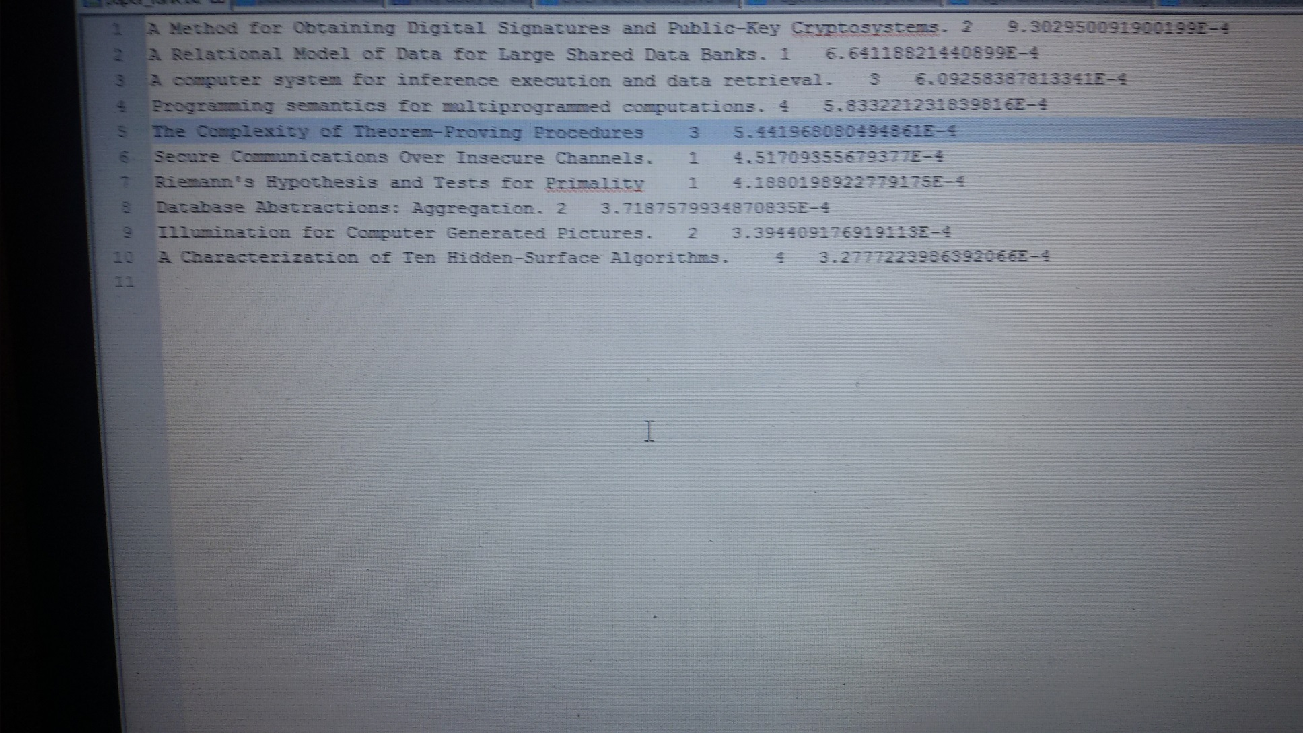
Hive Output

Slide 19
Conclusion
With page rank algorithm implementation using map reduce and hive scripts, we could find the top ten papers with highest page rank.

Slide 20
Reference
https://hadoop.apache.org/docs/r1.2.1/api/
https://cwiki.apache.org/confluence/display/Hive/LanguageManual
http://www.cs.princeton.edu/~chazelle/courses/BIB/pagerank.htm
http://pr.efactory.de/e-pagerank-algorithm.shtml

